Slide 6
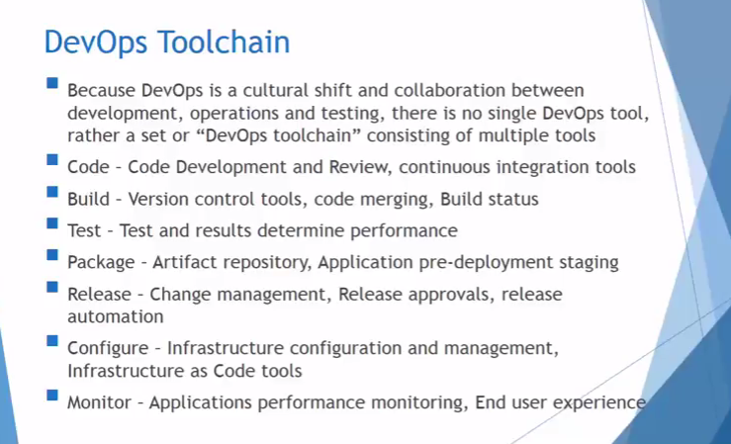

Slide 8
DevOps LifeCycle: tools

Slide 9
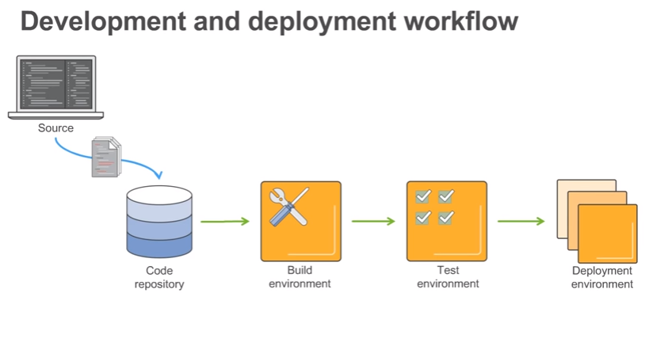

Slide 10
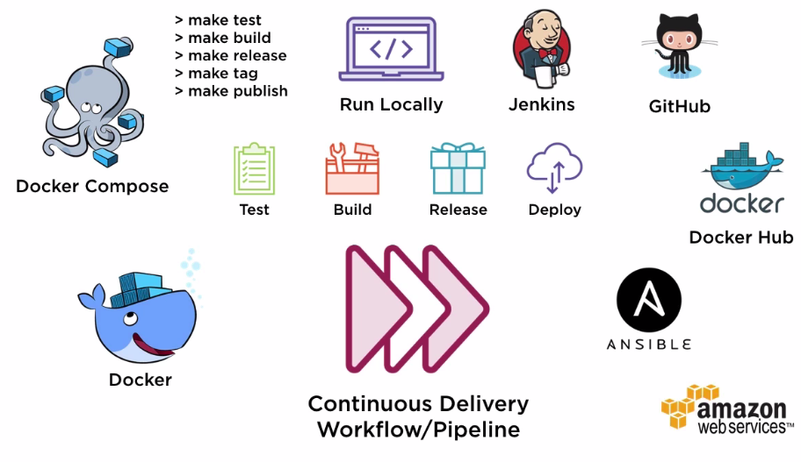
Continuous Delivery Pipeline

Slide 11
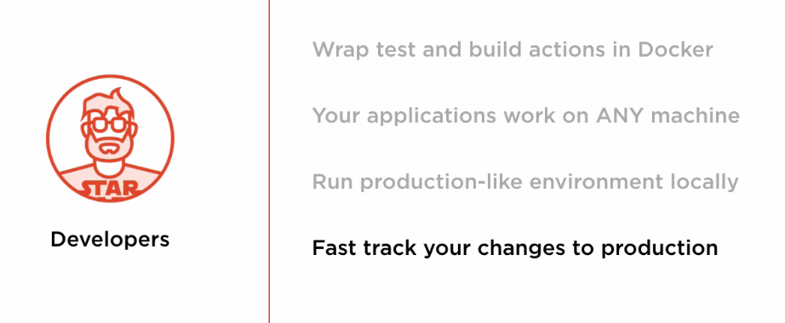

Slide 12
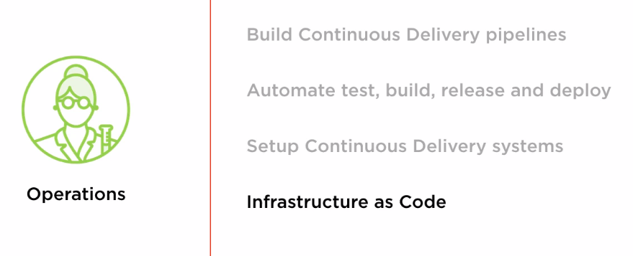

Slide 13
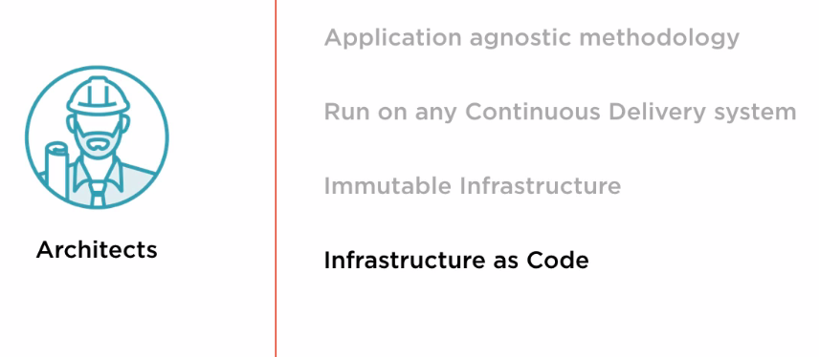

Slide 14
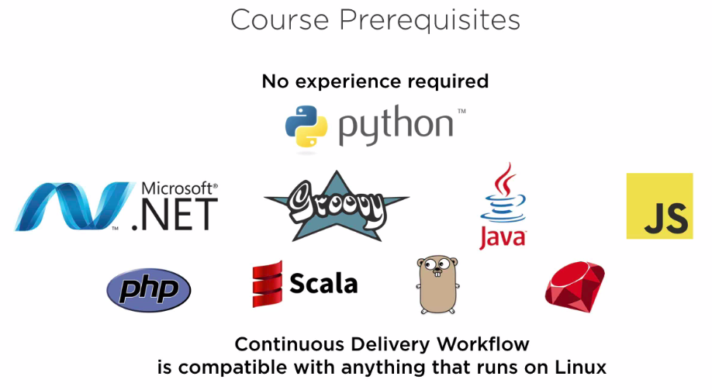

Slide 15
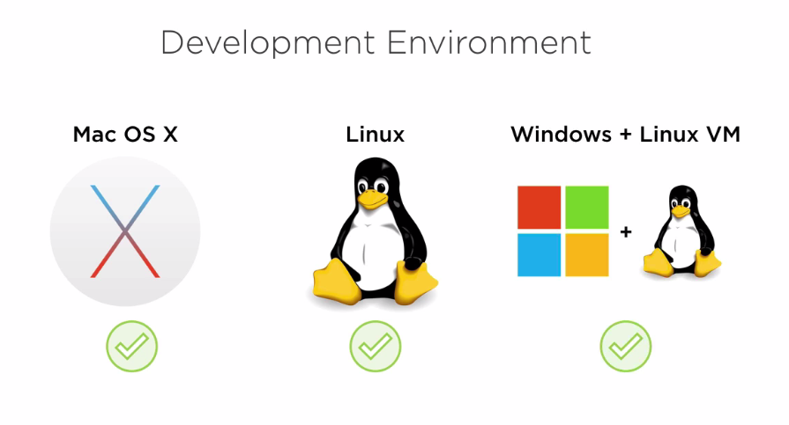

Slide 16
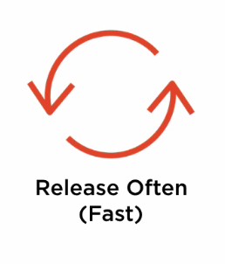

Why Continuous Delivery?

Slide 17
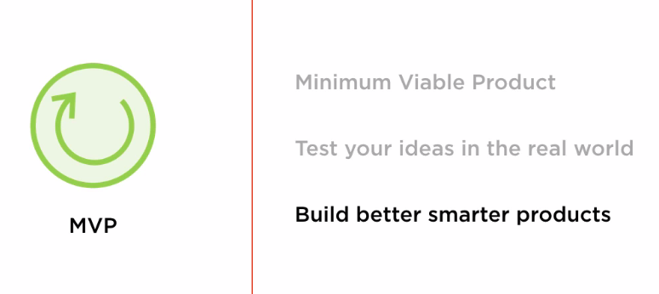
Continuous Delivery drives discipline of MVP

Slide 18
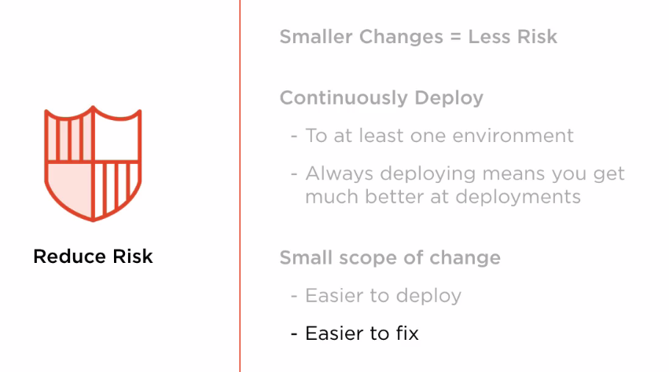
Continuous Delivery reduces Risk

Slide 19
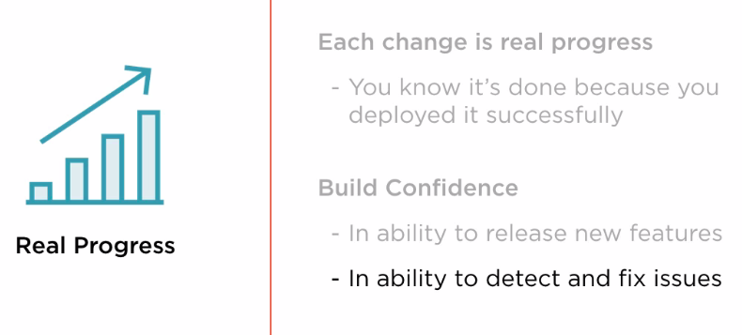
Continuous Delivery Comforts Real Progress

Slide 20
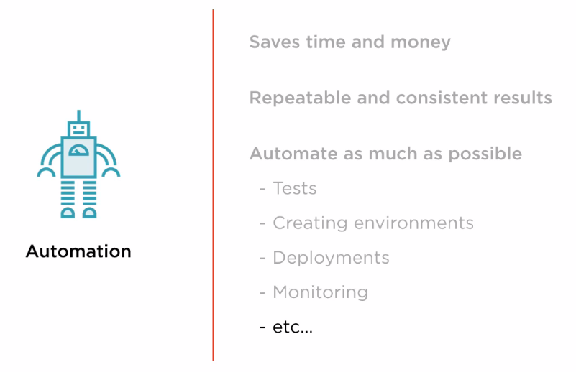
How to achieve Continuous Delivery

Slide 21
Docker Commands
Basic Docker fun:
Commands:
docker run<image>
docker start <name|id>
docker stop<name|id>
docker ps[-a include stopped containers]
docker rm<name|id>

Slide 22
